Slide 1


Training of deep Spiking Neural Networks (SNN) via hybrid conversion
EE 599 Deep Learning Spring 2020
Akshay Manjunath
Muhammad Waqas
Gourav Datta
Mentor: Souvik Kundu

Slide 2

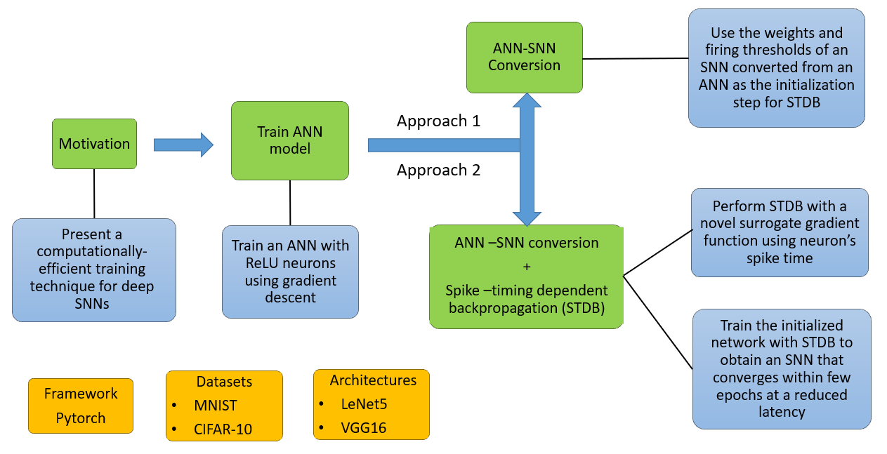
Overview

Slide 3

Motivation
Spiking Neural Networks (SNNs) promise higher energy efficiency in neuromorphic hardware implementations.
SNNs obtained through ANN – SNN conversion using suitable threshold balancing incur large latency leading to higher energy consumption.
Proposed solutions consist of two approaches
Conversion from traditional ANN to SNN with an appropriate threshold scaling.
A hybrid training technique which combines ANN-SNN conversion and training SNNs with spike-based backpropagation.
Evaluate our approaches on SNN architectures like VGG and LeNet on CIFAR10 and MNIST datasets respectively.
Achieve iso-accuracy compared to similar ANN architectures at lower compute cost and energy.

Slide 4
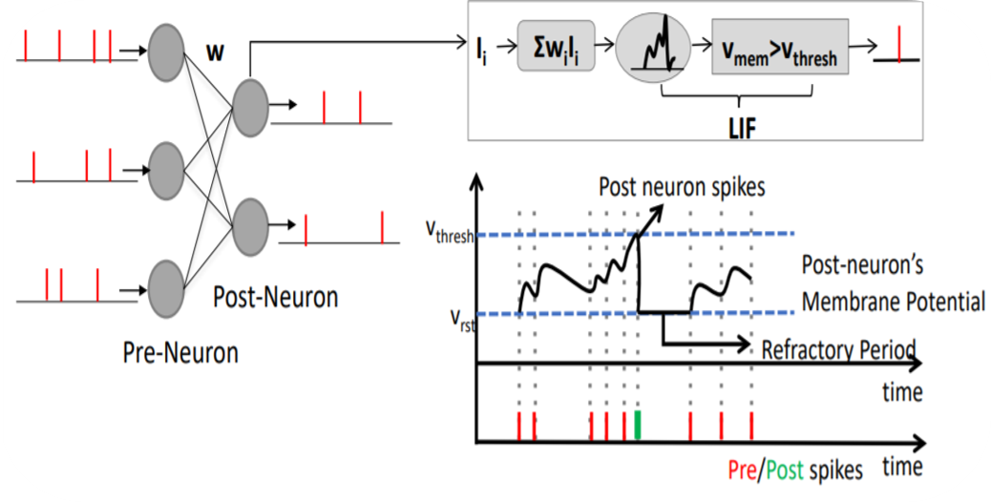
Spiking Neural Networks
Spiking neural networks (SNNs) use biologically-realistic models of neurons to carry out computation.
SNNs operate using spikes. The occurrence of a spike represents the membrane potential of the neuron.
Once a neuron reaches a certain potential, it spikes, and the potential of that neuron is reset. Most common model for this is the Leaky integrate-and-fire (LIF) model.
This type of information encoding is very robust to errors because a failure to detect a spike or two doesn’t induce a significant error on the average spike rate.

Slide 5
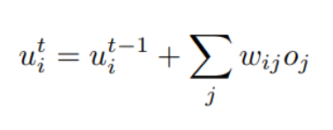
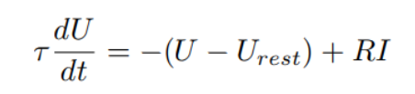
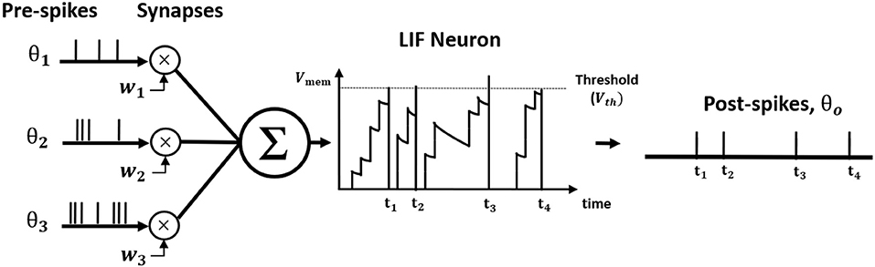
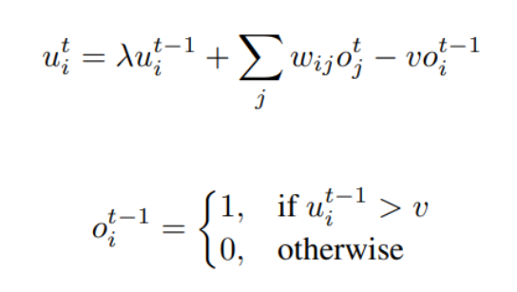
Spiking Neuron Model
The differential equation widely used to characterize the leaky-integrate-and-fire (LIF) neuron model is described by
The dynamics of the neuron in the output layer is described by
The iterative model for a single post-neuron is described by

Slide 6

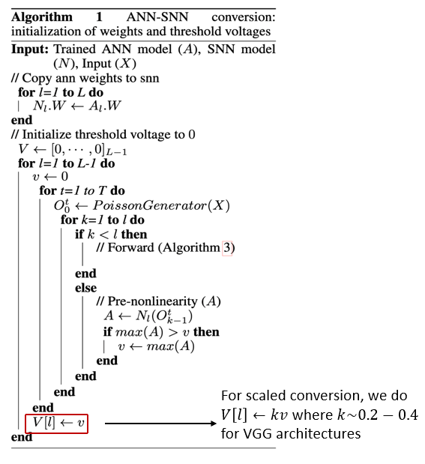
ANN-SNN Conversion
We propose to use the ANN – SNN conversion process as an initialization technique for STDB.
The threshold voltages in SNN needs to be adjusted based on the ANN weights.
To achieve this we employ threshold-balancing where the weights are unchanged and the threshold is set to the normalization factor.
Normalization factor corresponds to the maximum neuron activation for the corresponding convolution/linear layer in SNN.

Slide 7
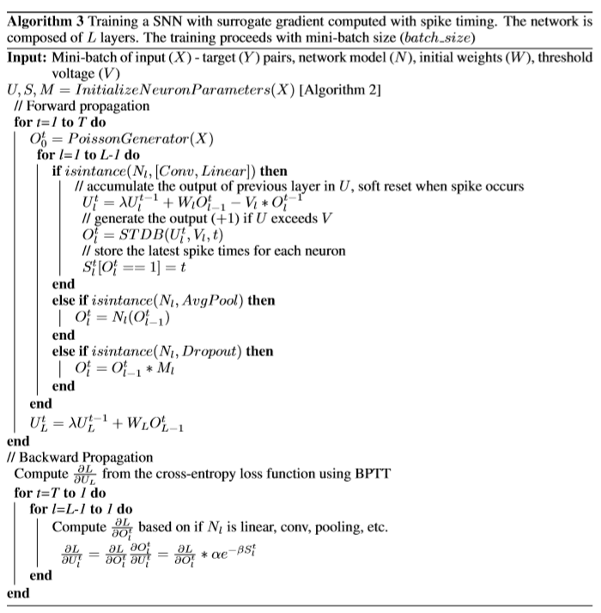
Training SNN
Initialize parameters of the SNN viz spike count, spike time, membrane potential
Do forward propagation based upon various SNN layers
Update the membrane potential of the neurons over all the time steps
Do backpropagation through time for all the SNN layers

Slide 8
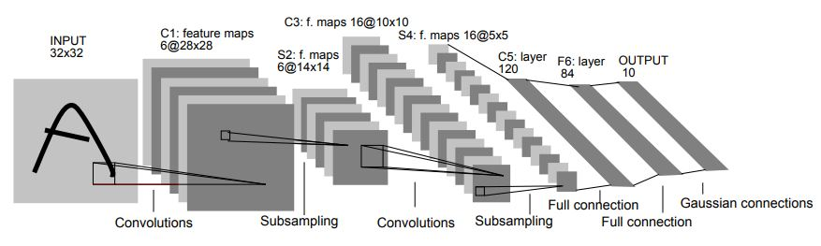
LeNet5 Architecture
Two conv layers with 5X5 kernel size
Two Avg pooling layers with 2X2 kernel size
3 fully connected layers for classification

Slide 9
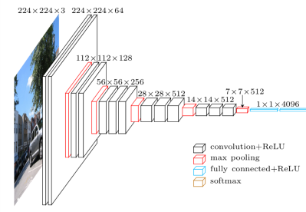
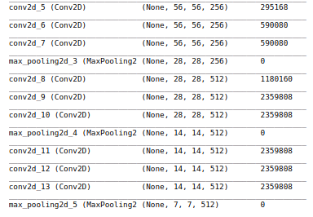
VGG-16 Architecture

Slide 10
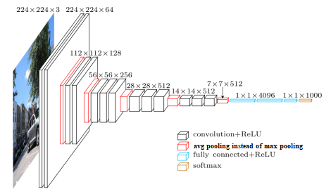
Trained VGG-16 Architecture
VGG16 is a convolution neural net (CNN )
No batch normalization due to absence of bias term
Avg Pooling is used as max pooling cannot extract required information due to binary nature of SNNs.
Number of layers = 16
138 million (approx) parameters.

Slide 11
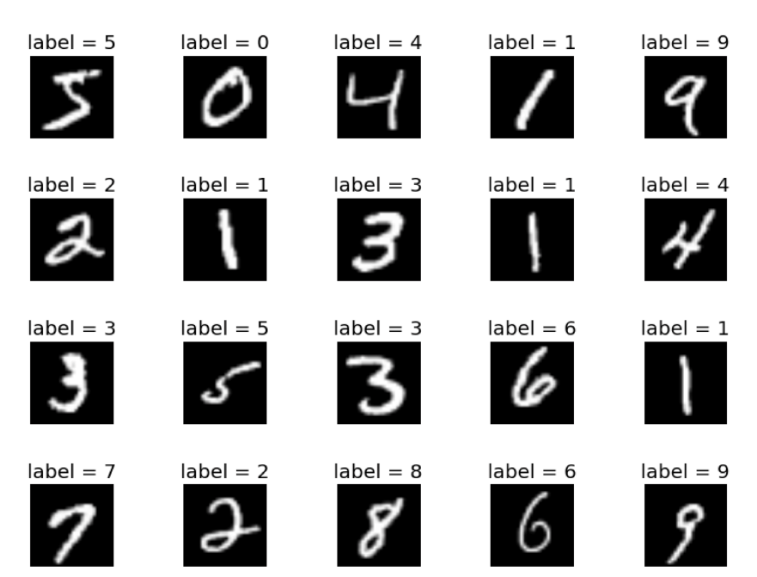
Dataset Description
MNIST for digit classification (http://yann.lecun.com/exdb/mnist/)
60,000 training examples in 10 classes.
10,000 test examples.
Each greyscale image is 28 x 28, representing the digits 0-9.

Slide 12
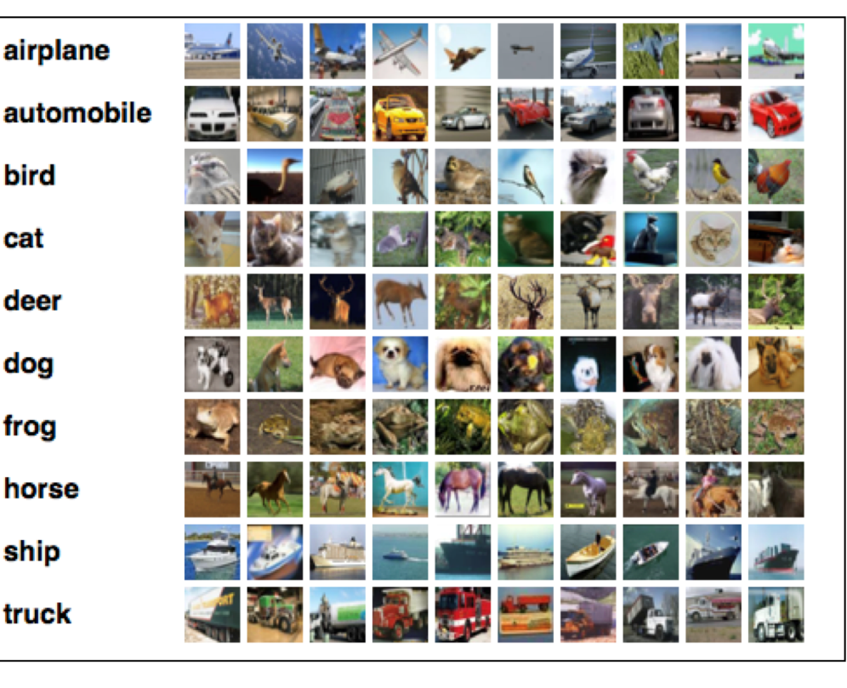
Dataset Description
CIFAR-10 (https://www.cs.toronto.edu/~kriz/cifar.html)
60,000 32x32 color images in 10 classes.
6,000 images per class.
50,000 training images and 10,000
test images.
Each color image is 32 x 32 in size.

Slide 13


Classification Results (Top-1) for MNIST and CIFAR-10
Optimal scaling factor for ANN-SNN Conversion in VGG architectures $\sim$ 0.7-0.9
STDB Training is performed for $\sim$ 5 epochs due to high SNN training time
Architecture | ANN | ANN-SNN Conversion (T=2500) | ANN-SNN Baseline Conversion (reduced time steps) | Hybrid Training(ANN-SNN conversion+STDB)
CIFAR-10
VGG5 | 87.96 | 86.84 | 85.97 (T=200) | 86.79 (T=200)
 |  |  | 85.46 (T=100) | 86.49 (T=100)
VGG9 | 91.37 | 91.11 | 89.96 (T=200) | 90.46 (T=200)
 |  |  | 85.12 (T=100) | 88.89 (T=100)
VGG16 | 92.55 | 92.48 | 91.13 (T=200) | 92.03 (T=200)
 |  |  | 84.64 (T=100) | 91.13 (T=100)
MNIST
LENET5 | 98.83 | 98.91 | 98.82 (T=100) | 98.88 (T=100)

Slide 14
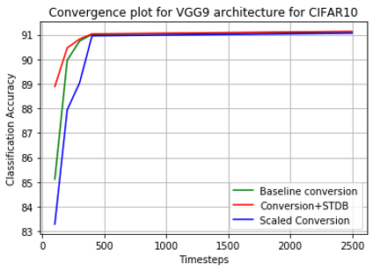
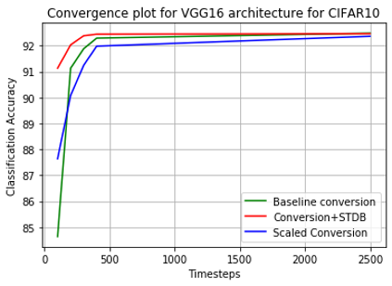
Convergence plots for VGG architectures

Slide 15
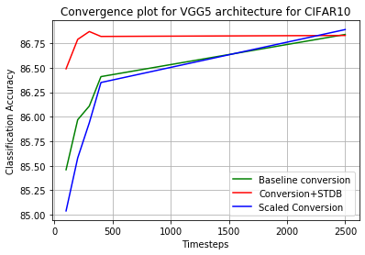
Convergence plots for VGG architectures
Performance of baseline conversion is similar to that of STDB for timesteps more than 200.
Scaled conversion performs worse than the other two approaches
VGG-architectures converge within 400 timesteps for all the three architectures

Slide 16
Convergence plots for VGG architectures
Performance of baseline conversion is similar to that of STDB for timesteps more than 200.
Scaled conversion performs worse than the other two approaches
VGG-architectures converge within 400 timesteps for all the three architectures
Model | Training Method | Architecture | Accuracy | Timesteps
Hunsberger & Eliasmith (2015) | ANN-SNN Conversion | 2Conv, 2Linear | 82.95 | 6000
Cao et al. (2015) | ANN-SNN Conversion | 3Conv, 2Linear | 77.43 | 400
Sengupta et al.(2019) | ANN-SNN Conversion | VGG16 | 91.55 | 2500
Lee at al. (2019) | Spiking BP | VGG9 | 90.45 | 100
Wu et al. (2019) | Surrogate gradient | 5Conv, 2Linear | 90.53 | 12
This work | ANN-SNN Conversion | VGG16 | 91.13 | 200
 | ANN-SNN Conversion and STDP | VGG16 | 92.03 | 200

Slide 17
Conclusion
Spiking Neural Networks (SNNs) are energy-efﬁcient and can lead low-power neuromorphic hardware implementations.
Direct training of SNN is computationally expensive and slow.
The direct training of SNN with backpropagation is computationally expensive and slow.
VGG and LeNet architecture are used to train ANN on MNIST and CIFAR10 dataset. The trained ANNs are then used to get SNNs. The trained SNN models have accuracy of 98.8% for LeNet on MNIST dataset and 91.42% for VGG on CIFAR10 dataset.
Future works: Decrease SNN training time and achieve state of the art accuracy.

Slide 18
Acknowledgement
Professor Keith Michael Chugg
Mentor: Souvik Kundu
TA’s: Olaoluwa Adigun, Jiali Duan, Kuan-Wen Huang, Arnab Sanyal

Slide 19

Question & Answer
Thank You

